Slide 1
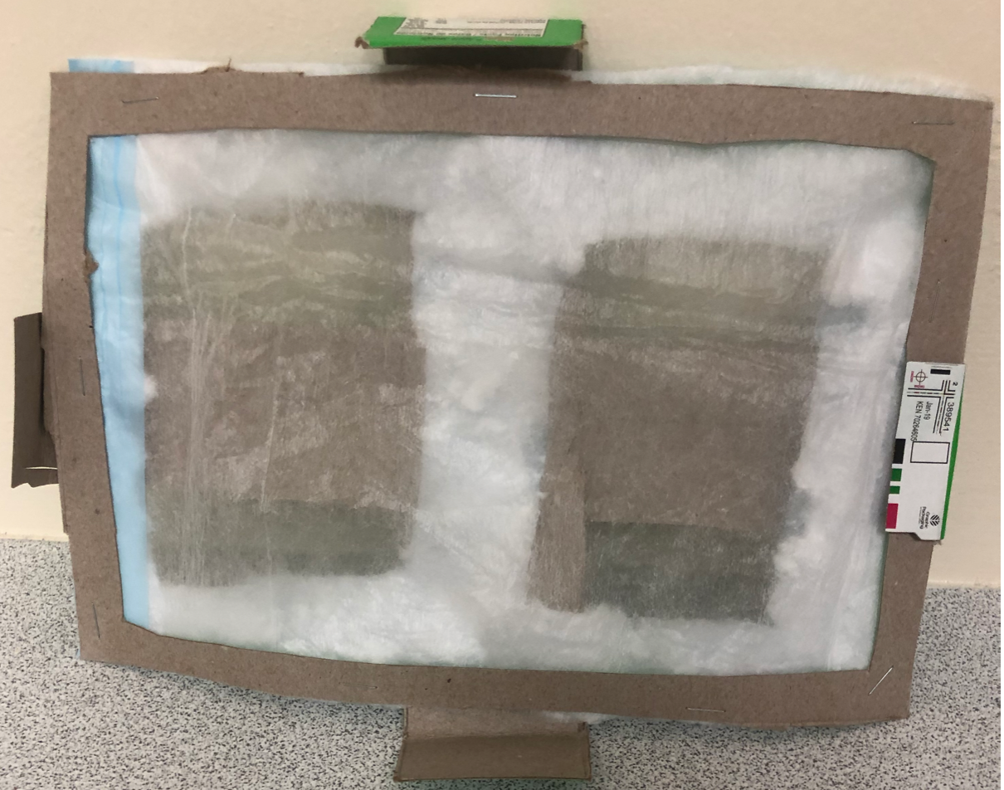
Filt-air
the problem?
Dorms go unused for months, yielding huge amounts of dust.
First year students get sick when they first move onto campus.
Not enough space in the dorm to comfortably fit an air purifier.
How might we...
create a space- & cost-efficient alternative to air purifiers that keep the air in the dorm rooms clean?
Charles Richardson
IDS1940
January 2020
Value proposition
Prevent new students from getting sick during their first week in an unfamiliar setting
Cheap, small, easy to install & replace
Eliminate chance of bad air entering the room to begin with.
Different sizes offered based on AC output size.
Target audience

